Slide 1

Introduction to Design Patterns in Software Engineering
Enhancing Software Design with Reusable Solutions
Presented by: Angsar Aidarbek
Date: 17/09/2024

Slide 2
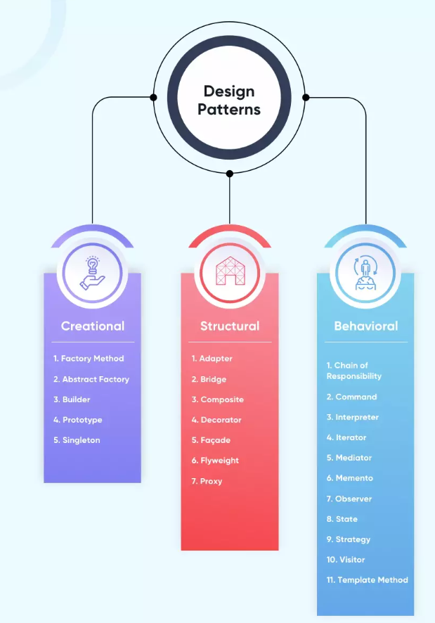
What Are Design Patterns?
Definition:
General, reusable solutions to common software design problems.
Not specific code, but adaptable templates.
Key Characteristics:
General and Reusable: Can be applied across different languages and projects.
Flexible: Serve as a guide, not rigid rules.
Categories:
Creational: Manage object creation (e.g., Factory Method, Singleton).
Structural: Organize classes and objects (e.g., Adapter, Decorator).
Behavioral: Focus on communication between objects (e.g., Observer, Strategy).
Importance:
Best Practices: Patterns bring reliability to software design.
Improve Communication: Common pattern names simplify team discussions.
Maintainability: Organized, modular code is easier to maintain.

Slide 3
History of Design Patterns
Origin:
Inspired by architect Christopher Alexander, who used patterns to solve architectural problems.
First introduced to software design by the Gang of Four (GoF).
Gang of Four (GoF):
1994 book: Design Patterns: Elements of Reusable Object-Oriented Software.
Defined 23 patterns categorized into Creational, Structural, and Behavioral.
Evolution:
Initially used in Object-Oriented Programming (OOP) but expanded to other paradigms.
Common in modern development frameworks and architectures (e.g., MVC).

Slide 4
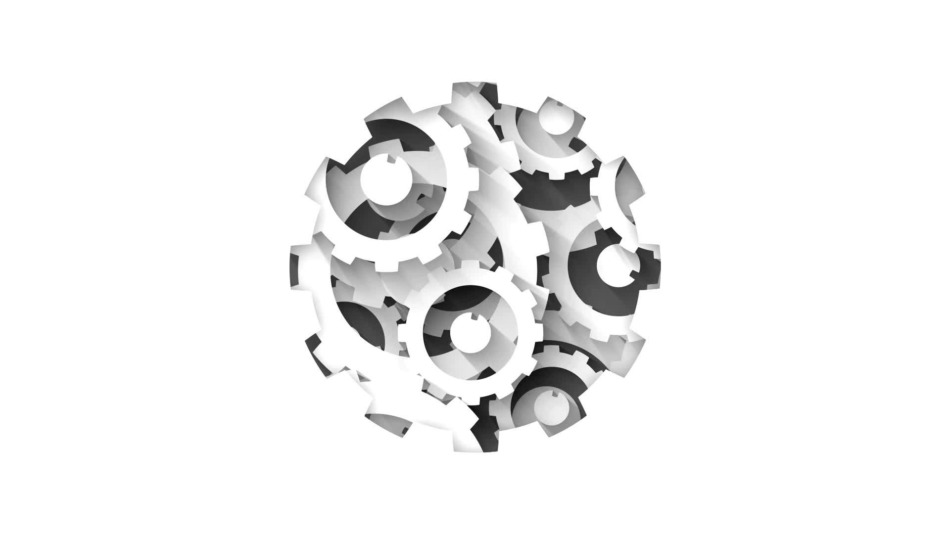
The Idea Behind Design Patterns
Problem-Solving Approach:
Patterns offer proven solutions to recurring software problems.
Solve issues related to object creation, structure, and communication.
Help avoid reinventing the wheel.
Reuse and Modularity:
Code reuse: Patterns allow developers to reuse solutions across different projects.
Modularity: Code is structured in independent, reusable components.

Slide 5

What Should Code Have to Be a Design Pattern?
Christopher Alexander defined design patterns as “any pattern that describes the task, that arises repeatedly throughout the job, as well as the steps to reproduce the solution, to reuse it a million times.”
A solution should have 4 aspects to be called a design pattern
Name: to describe a pattern it should have a name, to be acknowledged throughout the community
Task: the description of when to use the solution. The task and context must be clearly stated
Solution: the description of the solution’s elements, their relationship with each other, and the functionality of each element. The abstract explanation of the task and how it can be solved with the application of the elements inside the solution
Consequences: The influence on the flexibility, extensibility, and portability of the resultant system.
Question?

